Slide 1
SAP BTP Extension Suite Training
Day 32
Anubhav Oberoy
www.AnubhavTrainings.com
Follow excellence with sheer passion

Slide 2


DISCLAIMER
The training content and delivery of this presentation is confidential, and cannot be recorded, or copied and distributed to any third party, without the written consent of Anubhav Trainings

Slide 3
Agenda – Day 32
01
Deploy Process
02
Create Destination
03
Create app and invoke process

Slide 4

Scenario – Supplier App
🧑‍💼 Persona: Jack Dowson – Procurement Manager
Age: 34
Location: Chicago, USA
Industry: Manufacturing
Role: Manages procurement for factory suppliers
Goals:
Quickly find suppliers
Ensure availability to take orders based on size
On-board new suppliers with approvals
🎯 Objective
Design a user-friendly process that allows Alex to:
Enter product Id
Enter Supplier Id
Create approval request to procurement head
Once Approved, get notified

Slide 6

Hands-on Create process for Alex

Slide 7
sap_process_automation_service_user_access
https://help.sap.com/docs/build-process-automation/sap-build-process-automation/configure-sap-build-process-automation-destinations

Slide 8
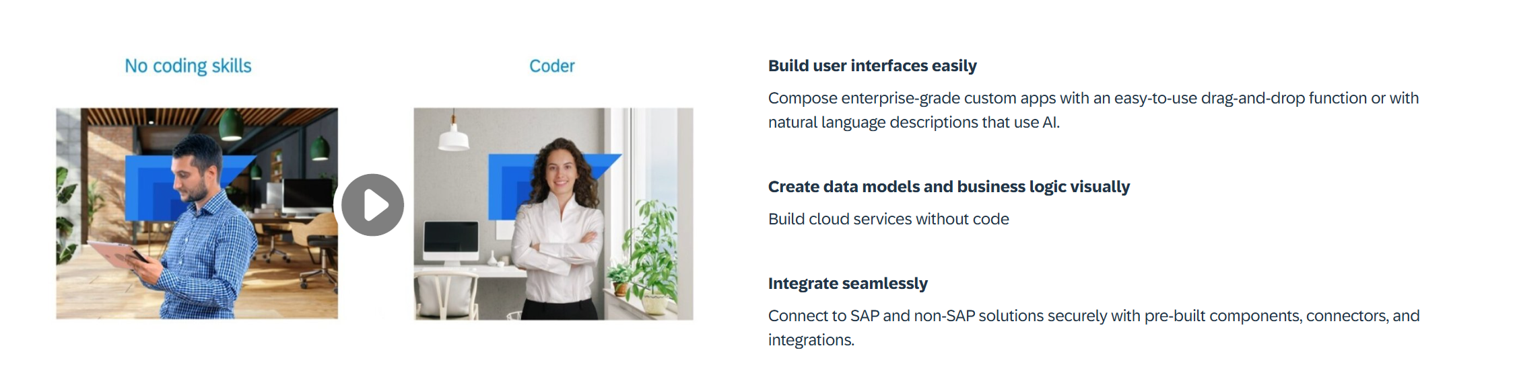
What is Build Apps?
SAP Build Apps is an AI-infused professional application development solution designed for anyone to quickly create apps without code regardless of role or skill level.

Slide 9
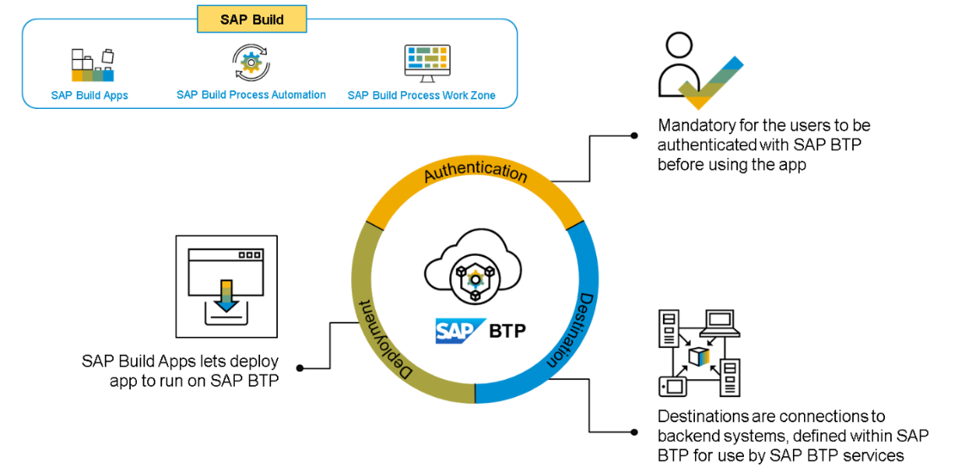
Core Capabilities?
Build Visually – SAP Build Capabilities enable customers to build visually, using drag-and-drop tools and intuitive interfaces. This allows users to quickly and easily design, configure, and deploy applications with no coding. By leveraging the SAP Build capabilities, customers can quickly create rich, interactive applications that streamline business processes, drive greater efficiency, and reduce operational costs. The tools are designed to be easy to use and are backed by a comprehensive library of pre-configured components, integration APIs, and data connectors.
Integrate Seamlessly – SAP Build capabilities help customers integrate their SAP solutions, applications, and systems with each other and with other systems and applications.
Collaborate Effectively – With its feature of seamless integration, SAP Build helps businesses leverage technologies like cloud-based tools with development teams to establish communication protocols like lifecycle management and built-in governance.

Slide 10
Design

Slide 11

What We Did
Let’s Summarize

Slide 12

www.anubhavtrainings.com
Thank You
End of Day 24

Slide 13


We’re committed to empower you to be
#FutureReady
through powerful training solutions.
We build the workforce of the future.
260+
Corporate Clients
60,000+
Learners Trained
26000+
Learners Placed
FREE WEBINARS
Sign up for free webinars with industry experts every fortnight!
Enroll Now!
Contact us today!
https://anubhavtrainings.com

